Slide 1


Mantid Scientific Steering Committee
Nick Draper
13/05/2011

Slide 2
This Release
Target Date
  6th May 2011
Huge release
  372 tickets (296 previous)
Multiple complications
  UK holidays
  Network connectivity
Still out on time
  With slightly less changes

Slide 3



This Release
Ongoing tasks
  Framework internals
    Ability to save any workspace type
      Currently missing Table Workspaces & MD workspaces
    Improved facility support
      SNS catalog support
      Multiple catalog searching
    Support if ISIS event data
  Mantidplot
    Instrument display improvements
  SANS
    SANS specific plotting & fitting
  Muon
    Analysis interface

Slide 4
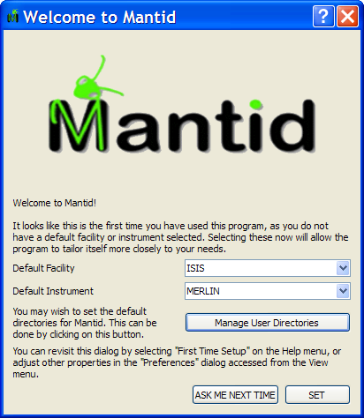
Progress over the last iteration
Installation
  Python 2.7 bundled for Windows.
    Also numpy
  MacOSX and RedHat have been rewritten.
  First use configuration form
    default facility, instrument and data paths.
Error Reporting
  Bug reporting form
    For pcs without an email client.
    mantid-help@mantidproject.org.

Slide 5
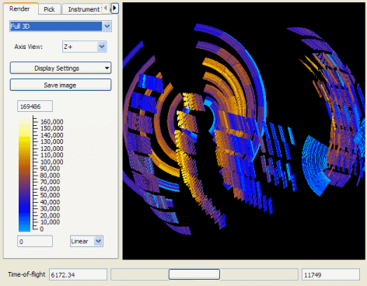
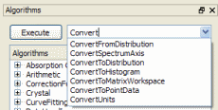
Progress over the last iteration
Instrument Display
  New integration range control.
  The colouring for counts <1.0 have been corrected.
Algorithm Toolbox
  The search box lists all possible matches.

Slide 6
Progress over the last iteration
Load
  file extensions are correctly respected
  case of the instrument prefix is ignored.
  Improved file filters when browsing for files.
Framework
  Mac Version 64 bit
    Multithreaded
    Python 2.6
  Algorithm improvements
    Aliases
    Deprecation
  Workspaces
    GroupWorkspaces
    PeaksWorkspace
    Hidden

Slide 7
Progress over the last iteration
Python Scripting
  More objects exposed to python
    EventWorkspaces, V3D (positions) and Quat (rotations).
  Data file paths and logging path can be set in python.
Model fitting and optimisation
  New form of composite function ProductFunctionMW
    multiplies the contained functions
  Errors are now calculated for simplex minimization
  The difference plot in the results is now optional.

Slide 8
Progress over the last iteration
Performance
  Threadpool added
    Reduce the creation overhead of threads for small tasks.
  GroupDetectors much faster when reading large xml grouping files.
  Fixed bugs in the memory management that caused workspaces to go managed too early.
  The performance of saving event nexus workspaces has been improved
    Disabled compression of the data
      increases the file size by roughly 20%
      much faster.

Slide 9
Progress over the last iteration
Direct Inelastic
  Diagnostics are now correctly applied to each file in turn and then the masks from each are summed.
SANS - ISIS
  The Mantid analysis now reproduces Colette results for circularly symmetric data in 1D
  All Nexus file reductions are now possible, an external .log file is no longer required
  Flexibility in the transmission calculation
    Any combination of monitors can be used or an externally calculated transmission
  Save options for SANS batch mode has been extended

Slide 10
Progress over the last iteration
Indirect Inelastic
  Unit conversion to/from Wavelength now takes account of the Emode property.
  TOSCA now takes account of frame overlap.
Crystallography
  Diffraction algorithms
    Now respect masking flag set on the workspace and the calibration file.
  TOF corrections for POWGEN
    UnwrapSNS and FilterLowResTOF
  Calibration of 2D detectors for powder diffraction
    optimizes whole detector position
  Preview of single crystal Bragg scattering reduction
  Fourier transform for PDF [S(Q) to G(r)].

Slide 11
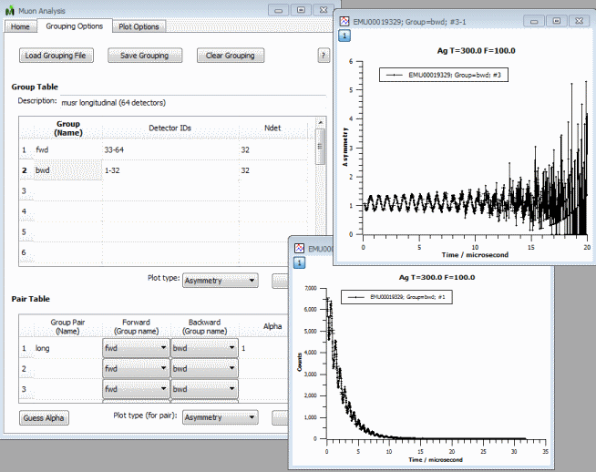
Progress over the last iteration
Muon
  Normalization of Asymmetry plot.
  Choices for bunching data.
  Auto-save MuonAnalysis user selected values.
  Updated various defaults including use micro-seconds only.

Slide 12
Progress over the last iteration
Instrument Definitions
  New GPSANS and OSIRIS definitions have been added.
  Definitions for VULCAN, LOQ, HIFI, TOSCA and IRIS have been improved.
  The parameter file for HRPD has been adjusted to give much better initial values for back to back exponential fitting.
New/ Improved Algorithms
  15 new algorithms or significant improvements
Crashes/Bugs
  31 Notable bugs corrected

Slide 13
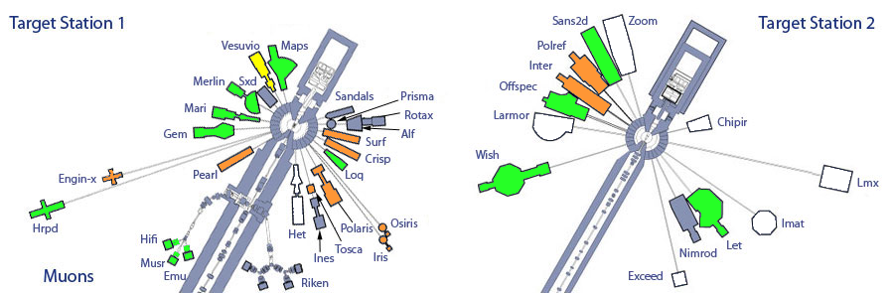
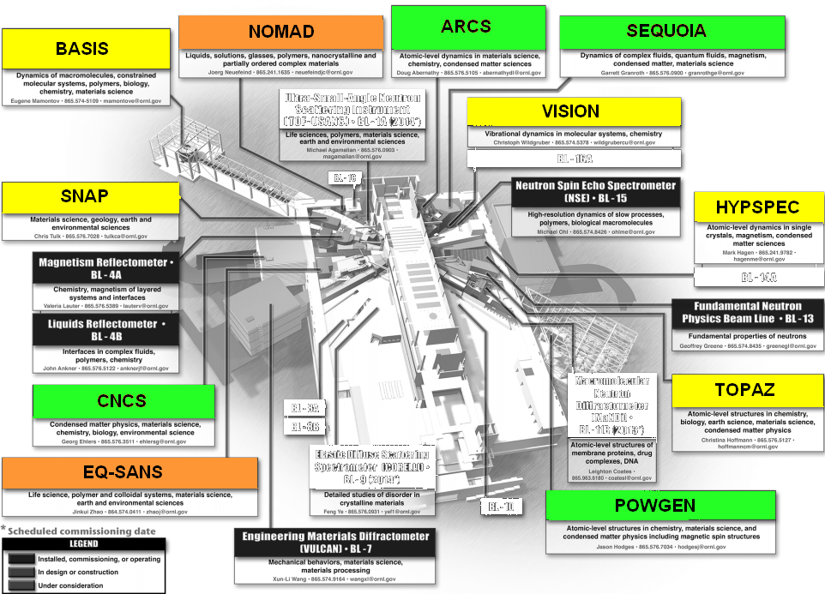
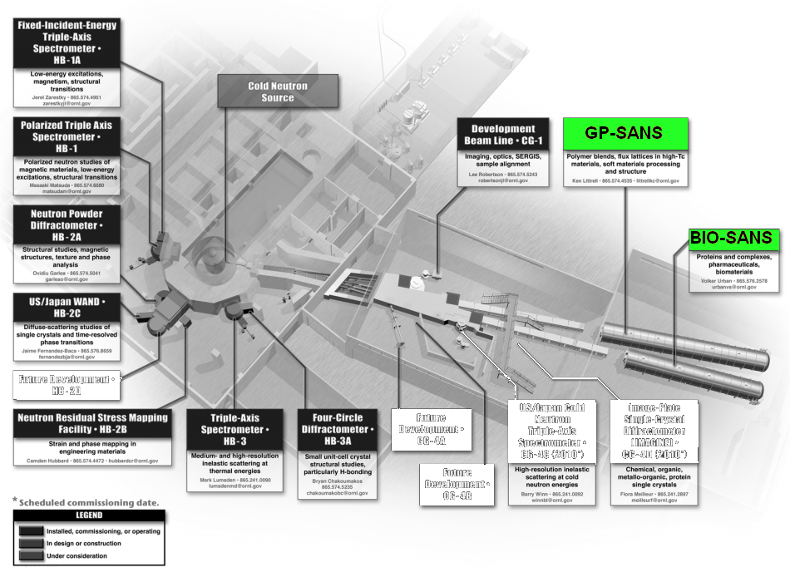
Rollout?
In
Use
ISIS
Under Evaluation
Active Development
SNS
HFIR

Slide 14
Next Release
Target Date
  1st July 2011
Prototype VATES release
  Aimed at early feedback from instrument scientists
  Not for production use
Problem areas and possible developments for discussion

Slide 15
Solid Angles - Current
Uses triangulation of shapes.
Identifies which triangles are “pointing” at the observer.
Sums the triangles solid angles.
Very Fast
Works with all shapes
Accurate
  Apart from problems

Slide 16
Solid Angles - Problems
Problem
  Doesn’t take into account shadowing from other components
Workaround
  Make detectors very thin!
  Problem
    Not obvious you should do this!
    Doesn’t work for tubes
      Workaround
        Do not consider the end caps for Cylinders
Not Ideal

Slide 17
Solid Angle - Other approaches
Consider all triangles in the instrument
  Really Slow
Consider all triangles within a certain spherical angle of each detector
  Pretty slow
Only consider triangle from the “Primary” surface of a shape
  The surface that is most closely oriented to the observer
Other ideas?

Slide 18
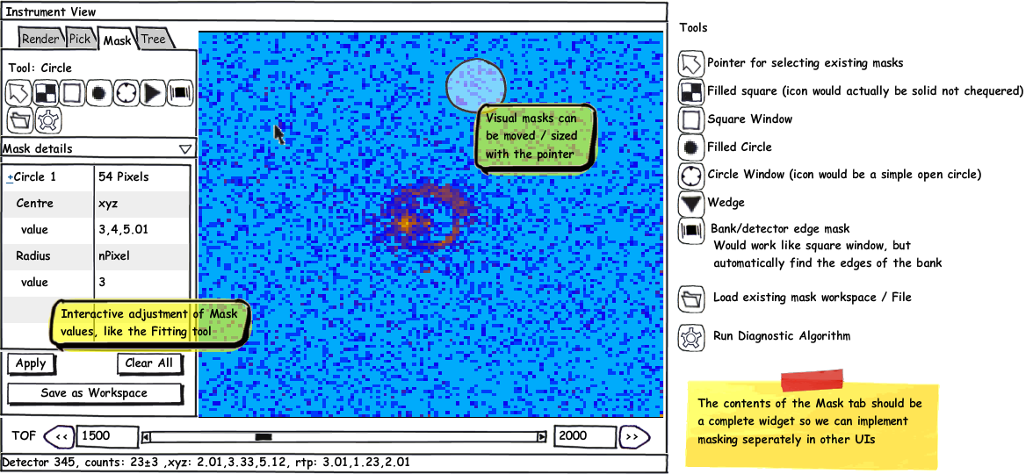

Masking Tab in the Instrument View

Slide 19
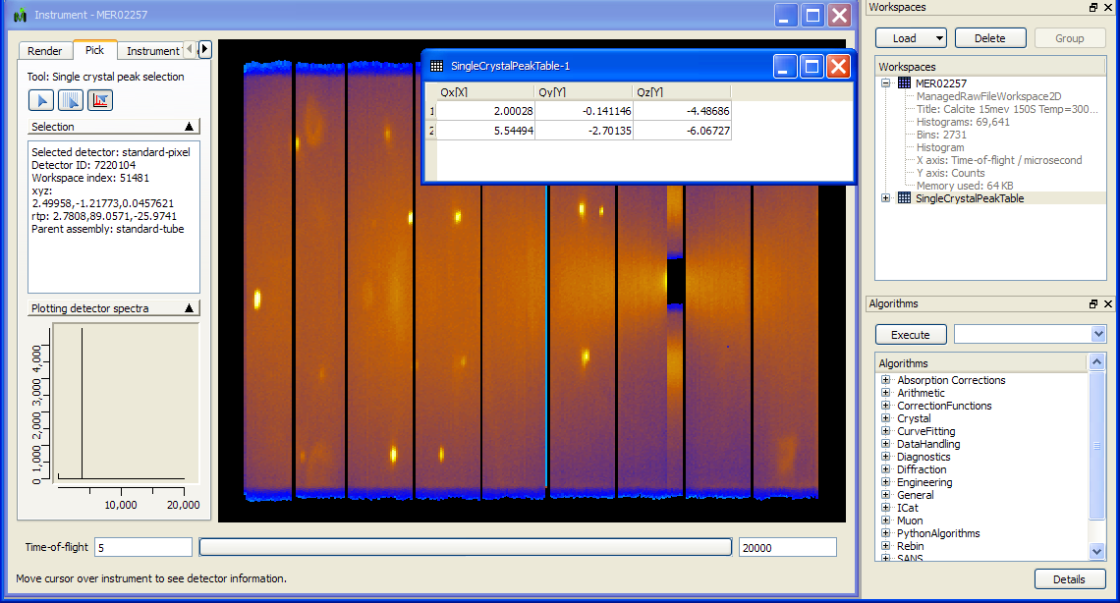
Single crystal peak picking tool in the instrument view

Slide 20
Plot and correctly regrid
SQW data
Current SQW plotting not correctly plotting pixel shape
Particularly important for small inelastic and reflectometry instruments
Current Rebinning
  only taking into account centre point of the detector
  1D at a time
Vital for refectometry and important step to supercede mSlice
Need to investigate different approaches

Slide 21

Move to distributed version control
Remote access to Shadow SVN from the US is not ideal
Shadow has had poor reliability lately
Distributed VC will allow for local hubs
Possibly an external master copy
ORNL
RAL
External Master?

